Slide 1
Circuits Design and Analysis
Session 6,7,8
SCIE6063
COMPUTATIONAL PHYSICS
June 2024

Slide 2
These slides have been adapted from
Halliday D.; Resnick R. and Walker J. (2018). Fundamentals Of Physics ,Extended,
11th , John Wiley & SONS Inc, New York, ISBN: 9781119306856
Chapter 27

Slide 3
1. Pumping Charges
In order to produce a steady flow of charge through a resistor, one needs a “charge pump,” a device that by doing work on the charge carriers maintains a potential difference between a pair of terminals.
Such a device is called an emf , or electromotive force.
A common emf device is the battery, used to power a wide variety of machines from wristwatches to submarines. The emf device that most influences our daily lives is the electric generator, which, by means of electrical connections (wires) from a generating plant, creates a potential difference in our homes and workplaces.
Some other emf devices known are solar cells, fuel cells.

Slide 4

Pumping Charges
Crimson Storage, the world’s largest single-phase battery, which is now live in the California desert, USA. Crimson Storage is also the second-largest energy storage project currently in operation of any configuration.
The 350 megawatt (MW)/ 1400 megawatt-hour (MWh) battery storage project, which sits on on 2,000 acres west of Blythe in Riverside County, broke ground in 2021. Residential homes are usually served by a single-phase power supply, and this project, on average, is expected to store and dispatch enough electricity to power more than 47,000 homes each year.
https://electrek.co/2022/10/19/the-worlds-largest-single-phase-battery-is-now-up-and-running/#:~:text=The%20350%20megawatt%20(MW)%2F,County%2C%20broke%20ground%20in%202021.

Slide 5

In any time interval dt, a charge dq passes through any cross section of the circuit shown, such as aa’. This same amount of charge must enter the emf device at its low-potential end and leave at its high-potential end.
The emf device must do an amount of work dW on the charge dq to force it to move in this way.
We define the emf of the emf device in terms of this work:
2. Work, Energy, and Emf
i
a
a’
ε
R
i
i
Fig.1. A simple electric circuit, in which a device of emf ε does work on charge carries and maintains a steady current i in a resistor of resistance R.

Slide 6
Work, Energy, and Emf (cont.)
An ideal emf device is one that has no internal resistance to the internal movement of charge from terminal to terminal.
The potential difference between the terminals of an ideal emf device is exactly equal to the emf of the device.
A real emf device, such as any real battery, has internal resistance to the internal movement of charge.
When a real emf device is not connected to a circuit, and thus does not have current through it, the potential difference between its terminals is equal to its emf. However, when that device has current through it, the potential difference between its terminals differs from its emf.

Slide 7

3. Calculating the Current in a Single-Loop Circuit
The battery drives current through the resistor, from high potential to low potential.
The equation P =i ²R tells us that in a time interval dt an amount of energy given by i²R dt will appear in the resistor, as shown in the figure, as thermal energy.
During the same interval, a charge dq =i dt will have moved through battery B, and the work that the battery will have done on this charge, is
i
Higher potential
ε
i
R
i
B
Lower potential
i
Fig.2. A single-loop circuit in which a resistance R is connected across an ideal battery B with emf ε.
The resulting current i is the same through out the circuit.

Slide 8



Calculating the Current in a Single-Loop Circuit (cont.)
From the principle of conservation of energy, the work done by the (ideal) battery must equal the thermal energy that appears in the resistor:
Therefore, the energy per unit charge transferred to the moving charges is equal to the energy per unit charge transferred from them.

Slide 9
The battery drives current through the resistor, from high potential to low potential.
Potential Method
LOOP RULE: The algebraic sum of the changes in potential encountered in a complete traversal of any loop of a circuit must be zero
i
Higher potential
ε
B
R
i
Lower potential
In the figure, let us start at point a, whose potential is V_{a}, and mentally go clockwise around the circuit until we are back at a, keeping track of potential changes as we move.
i
Fig.3. A single-loop circuit in which a resistance R is connected across an ideal battery B with emf ε. The resulting current i is the same throughout the circuit.

Slide 10


Calculating the Current in a Single-Loop Circuit (cont.)
Our starting point is at the low-potential terminal of the battery. Since the battery is ideal, the potential difference between its terminals is equal to E.
As we go along the top wire to the top end of the resistor, there is no potential change because the wire has negligible resistance.
When we pass through the resistor, however, the potential decreases by iR.
We return to point a by moving along the bottom wire. At point a, the potential is again V_{a}. The initial potential, as modified for potential changes along the way, must be equal to our final potential; that is,

Slide 11
Calculating the Current in a Single-Loop Circuit (cont.)
For circuits that are more complex than that of the previous figure, two basic rules are usually followed for finding potential differences as we move around a loop:
RESISTANCE RULE: For a move through a
resistance in the direction of the current, the change
potential is –iR; in the opposite direction it is +iR.
EMF RULE: For a move through an ideal emf devise in
the direction of the emf arrow, the change in potential
is +ε; in the opposite direction it is –ε

Slide 12
4. Internal Resistance
ε
i
i
ε
ir
i
ε
iR
V_{a} V_{a}
i
emf devise resistor
(a)
(b)
Fig. 4. (a) A single loop circuit containing a real battery having internal resistance r and emf ε.
(b) The same circuit now spread out in a line. The potentials encountered in traversing the circuit clockwise from a are also shown. The potential Va is arbitrarily assigned a value zero, and other potential in the circuit are graphed relative to Va.

Slide 13


Internal Resistance (cont.)
The figure above shows a real battery, with internal resistance r, wired to an external resistor of resistance R. According to the potential rule,

Slide 14


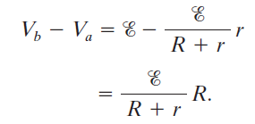

6: Potential between two points
Going clockwise from a:
The internal resistance reduces the potential difference between the terminals.
b
i
r=2 Ω
R=4Ω
ε=12V
a
i
Fig.6. Points a and b, which are at the terminals of real battery, differ in potential

Slide 15



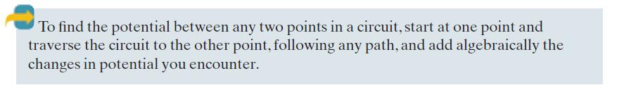
Potential between two points (cont.)
Going counterclockwise from a:

Slide 16
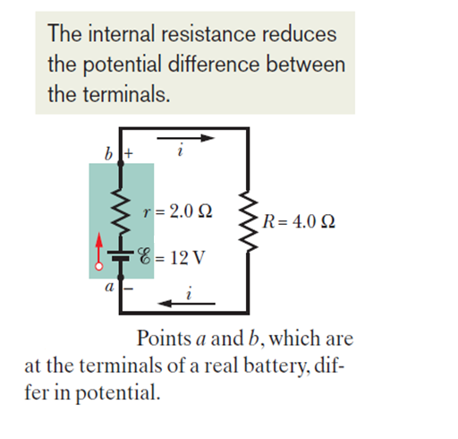
Potential between two points (cont.)
Potential across a real battery:
If the internal resistance r of the battery in the previous case were zero, V would be equal to the emf E of the battery—namely, 12 V. However, since r =2.0Ω ,
V is less than E.
The result depends on the value of the current through the battery. If the same battery were in a different circuit and had a different current through it, V would have some other value.
Fig. 7.

Slide 17
Potential between two points (cont.)
Grounding a Circuit:
Fig. 8. (a) Point a is directly connected to ground
(b) Point b is directly connected to ground. 2,0 Ω and R=4,0 Ω
b + i
b + i
r R
r R
ε=12V
ε=12V
a - i
a - i
(a)
(b)
This is the same example as in the previous slide, except that battery terminal a is grounded in Fig. 8a. Grounding a circuit usually means connecting the circuit to a conducting path to Earth’s surface, and such a connection means that the potential is defined to be zero at the grounding point in the circuit.
In Fig. 8a, the potential at a is defined to be V_{a} =0. Therefore, the potential at b is V_{b} =8.0 V.

Slide 18
Potential between two points (cont.)
Power, Potential, and Emf:
The net rate P of energy transfer from the emf device to the charge carriers is given by: P = i V
where V is the potential across the terminals of the emf device. But V = ε – ir therefore P= i(ε – ir) = iε – i²r
But P_{r} is the rate of energy transfer to thermal energy within the emf device:
P_{r} =i²r (internal dissipation rate )
Therefore the term iε must be the rate P_{emf} at which the emf device transfers energy both to the charge carriers and to internal thermal energy.
P_{emf} = i ε ( power of emf device )

Slide 19
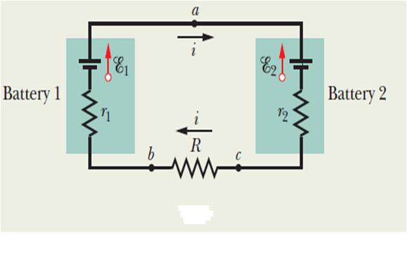
Potential between two points (cont.)
Example, Single loop circuit with two real batteries:
Fig. 9.
The emfs and resistances in the circuit of Fig. 9. have the following values : ε₁=4,4 V , ε₂=2,1 V , r₁=2,3 Ω ; r₂=1,8 Ω ; R=5,5 Ω .
(a) What is the current i in the circuit?
(b) What is the potential difference between the terminals of
battery 1?.

Slide 20
7. Multi-loop Circuits
Junction Rule: The sum of the currents entering any junction must be equal to the sum of the currents leaving that junction
ε₁
ε₂
a b c
i₁ i₃ i₂
R₁ R₂ R₃
d
Fig. 9. A multiloop circuit consisting of three branches: left-hand branch b-a-d, right-hand branch b-c-d, and central branch b-d. The circuit also consist of three loops: left-hand loop b-a-d-b, right-hand branch b-c-d-b, and big loop b-a-d-c-b.

Slide 21


7. Multi-loop Circuits
Consider junction d in the circuit. Incoming currents i₁ and i₃, and it leaves via outgoing current i₂. Since there is no variation in the charge at the junction, the total incoming current must equal the total outgoing current: i₁ + i₃ = i₂
This rule is often called Kirchhoff’s junction rule (or Kirchhoff’s current law, KCL).
For the left-hand loop,
For the right-hand loop,
And for the entire loop,

Slide 22
8: Resistors in Series and Parallel
When a potential difference V is applied across resistances connected in series, the resistances have identical current i. The sum of the potential differences across resistances is equal to the applied potential difference V.
Resistances connected in series can be replaced with an equivalent resistance R_{eq} that has the same current i and the same total potential difference V as the actual resistances.
a
i
a
i
ε
R₁
ε
R₂
R_{eq}
i
R₃
i
b
b
i
(a)
(b)
i
Fig. 5. (a) Three resistors are connected in series between points a and b. (b) An equivalent circuit with the three resistors replaced with their equivalent resistance R_{eq}

Slide 23






Resistors in Series

Slide 24
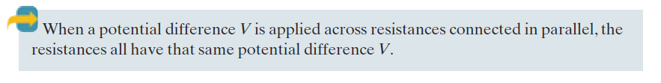
Resistors in Series
i
b
i₂+i₃
b
i
ε
ε
R₁
R₃
R_{eq}
R₂
i
i₁
i₂
i₃
i
i
a
a
i₂+i₃
(a)
(b)
Fig.10. (a) Three resistors connected in parallel across points a and b. (b) An equivalent circuit, with the three resistors replaced with their equivalent resistance

Slide 25





Resistors in Parallel
where V is the potential difference between a and b. From the junction rule,

Slide 26
Resistors in Parallel
Example, Resistors in Parallel and in Series
i₁ i₃
R₁ R₃
ε
R₂
i₂
R₄
A multiloop circuit containing one ideal battery and four resistances with the following values: R₁= 20 , R₂= 20 , R₃=30 , R₄=8,0 , ε= 12 V
(a) What is the current through the battery?
(b) What is the current i₂ through R₂ ?
(c) What is the current i₃ through R₃ ?

Slide 27
9. Ammeter and Voltmeter
i
An instrument used to measure currents is called an ammeter. It is essential that the resistance R_{A} of the ammeter be very much smaller than other resistances in the circuit.
A meter used to measure potential differences is called a voltmeter. It is essential that the resistance R_{V} of a voltmeter be very much larger than the resistance of any circuit element across which the voltmeter is connected.
ε
R₂
r
c
d
a
b
A
R₁
V
i
Fig.12. A single-loop circuit, showing how to connect an ammeter(A) and a voltmeter(V).

Slide 28


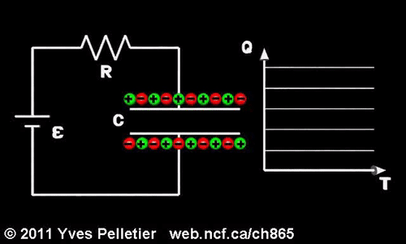

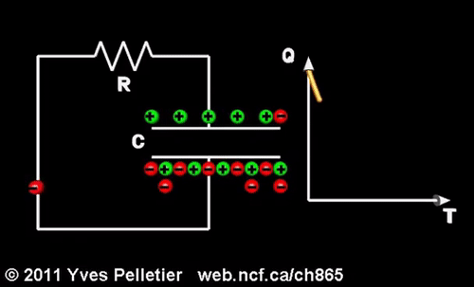
a
b
S
10. RC Circuits
R
ε
C
It turns out that:
We know that: I = dq / dt
Fig.13. When switch S is closed on a, the capacitor is charged through the resistor. When the switch is afterward closed on b, the capacitor discharges through the resistor.
A capacitor that is being charged initially acts like ordinary connecting wire relative to the charging current. A long time later, it acts like a broken wire

Slide 29


The product RC is called the capacitive time constant of the circuit and is represented with the symbol τ:
At time t= τ =( RC), the charge on the initially uncharged capacitor increases from zero to:
During the first time constant τ the charge has increased from zero to 63% of its final value CE.

Slide 30


RC Circuits (cont.)
Discharging a Capacitor
Assume that the capacitor of the figure 13, is fully charged to a potential V₀ equal to the emf of the battery ε.
At a new time t =0, switch S is thrown from a to b so that the capacitor can discharge through resistance R.
Source: Halliday, et All 2010

Slide 31
Assignment
Do the problems in the text-book: Fundamental of Physics, Chapter 27 (Circuits); p.795-802
Problems Number: 8, 19, 33, 24, 45, 51 and 58

